Slide 1


NEXT Orientation Session
Northwestern Alumni Association
Northwestern Career Advancement
Notes:
NCA

Slide 2
Definition and Expectations
What is an Externship?
  Provides you the opportunity to interact with and observe a professional in a career you are interested in pursuing.
How long is an Externship?
  Typically one day, but can be negotiated between you and your alumni host.
What can I expect from an Externship?
  To gain experience and knowledge through observing and speaking with the host employer in their virtual or in-person work environment.
Notes:
NCA
This opportunity will help you gain insight into the practical aspects of a potential future career.

Slide 3

Who Can Participate in NEXT?
Any Northwestern student in a degree granting program
  All undergraduate and graduate students
  School of Professional Studies students in degree-granting programs (e.g. B.S., B.A.,BGS)*
  *NEXT is not open to students in School of Professional Studies certificate programs or students-at-large

Slide 4

Learning Outcomes for NEXT
By participating in NEXT you will be able to…
List the typical duties associated with the job of the alumni host you shadow
Describe the skills/qualities needed to be successful in the job you observed
Articulate the advantages and
disadvantages of pursuing a career
in the industry you learned about
through shadowing in the context of your
personal skills, interests, and goals
Notes:
NCA

Slide 5

Sample of Externships
​Chicago Cubs
Disney ABC Television Group
General Motors
Hospitals & Healthcare Organizations (variety)
IBM
JP Morgan
NBC Universal​
San Francisco Ballet
Squarespace
The Wall Street Journal
Tiktok
US Department of Justice
Warner Bros. Animation & Warner Bros. Television​
Notes:
NCA

Slide 6

Application Process
Complete your profile as soon as possible to allow for approval time
Apply for up to 8 externships
  Tailored narrative for each externship
  Upload an anonymous resume for each externship
Timeline:
  Apply for your selected externships
  by November 12
  Matches will be completed
  week of December 6
  All matched students complete virtual training session
  by January 12
  Students reach out to alumni hosts within a week
  All externships to be complete
  between time of match and June 2026
Notes:
NAA
Will share this slide through email with students prior to the training as well since many may have already contacted their alumni hoost upon learning their match.

Slide 7
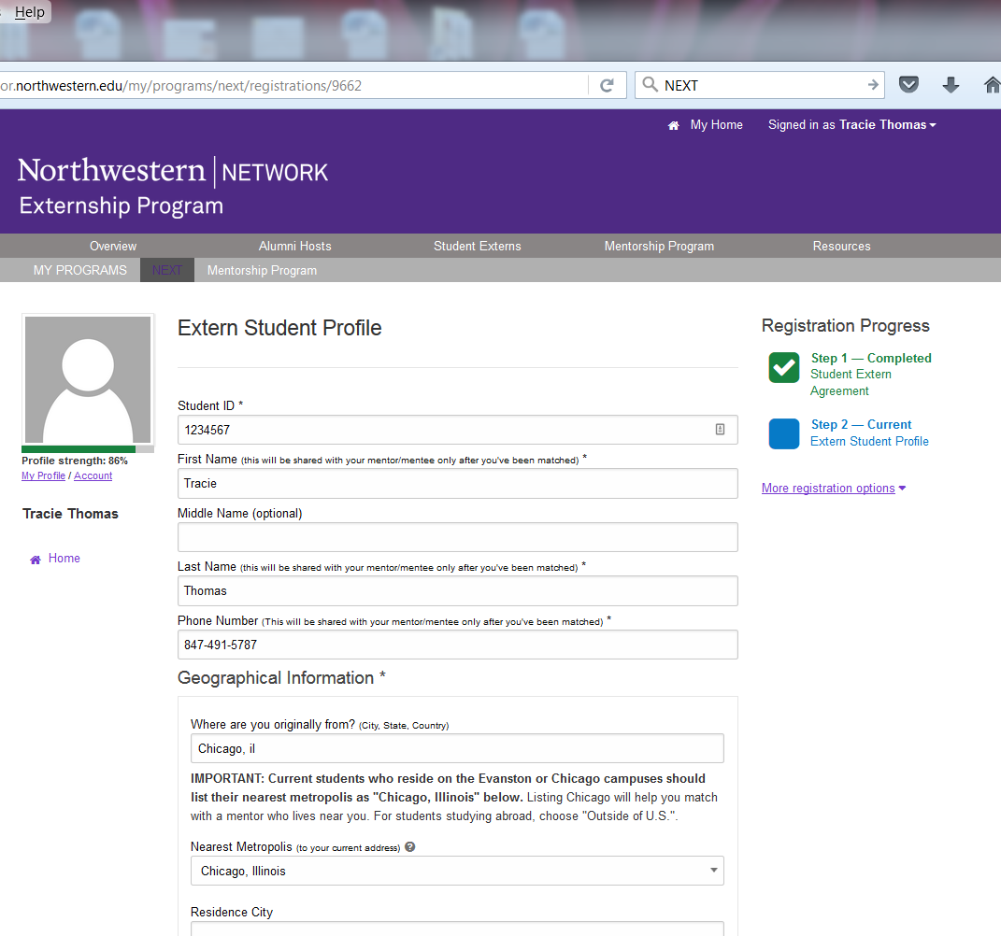
Fill out student profile information (degree details and career interests)
Once profile is completed, you will receive an email stating that your profile has been completed. It can take the NAA 1-2 business days to approve your profile.
Notes:
NAA

Slide 8
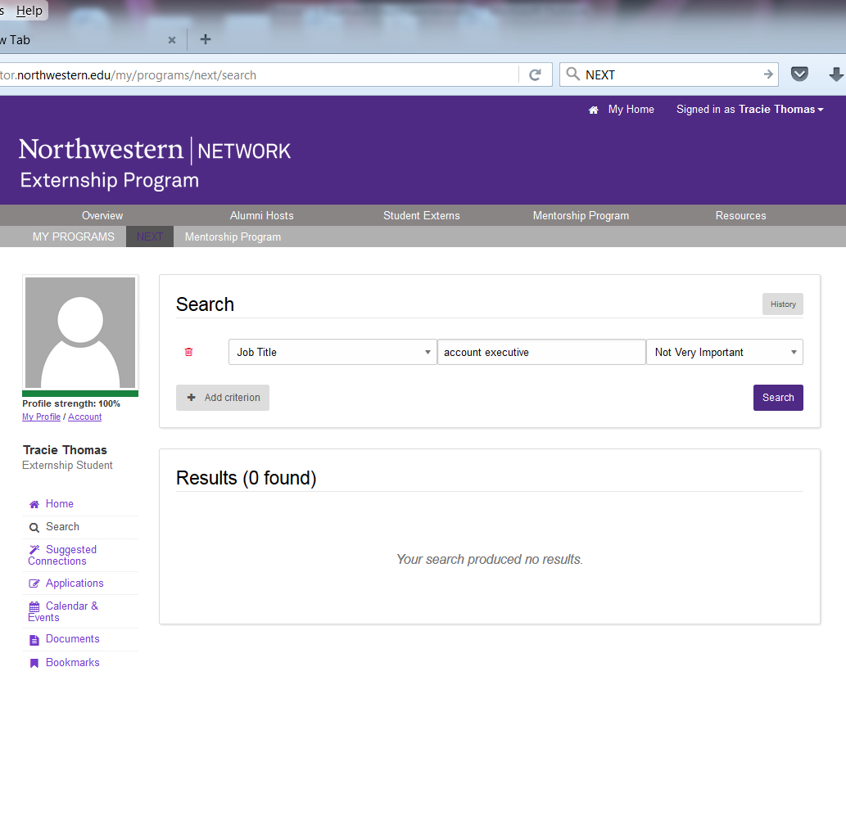
Once the application period is open (October 31– November 12) and your registration is approved, you can log in and click on “Search” to begin searching.
Notes:
NAA

Slide 9
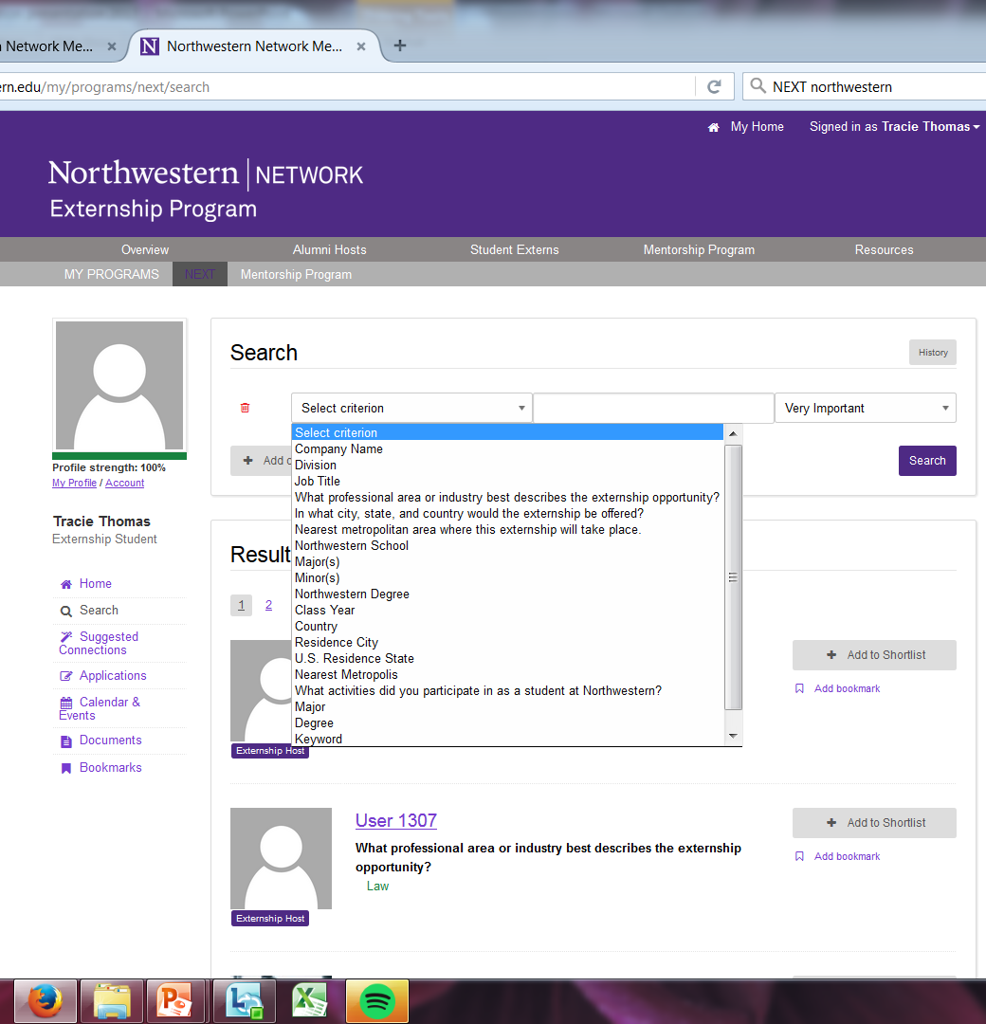
Select criteria for externships.
You can search by industry, location, company, in-person or virtual, and more.
Notes:
NAA
Include some basic tips about searching:
Location – use metro area
industry vs. field of specialty
Demographic information

Slide 10
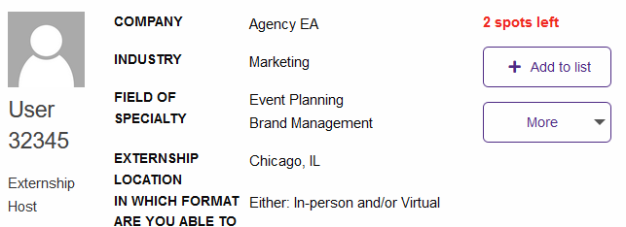
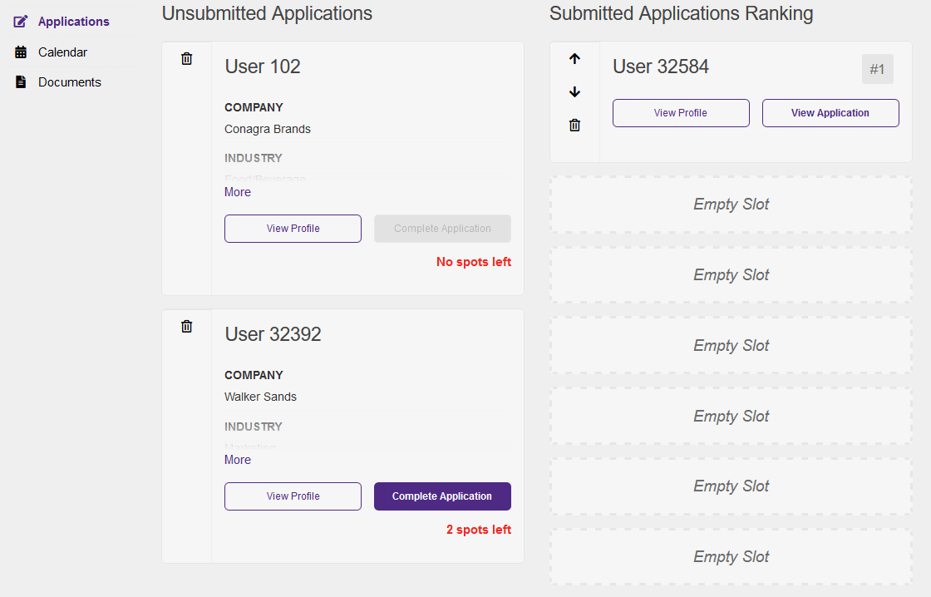
1. Add the hosts/opportunities of interest to your list.
2. Go to your "Applications" and complete applications for each opportunity. You can apply to up to 8 opportunities.
3. You may complete and submit each application as you complete each one.
4. Rank your preference of applications. You may adjust the rankings of your apps until the deadline on November 12.
Notes:
NAA

Slide 11
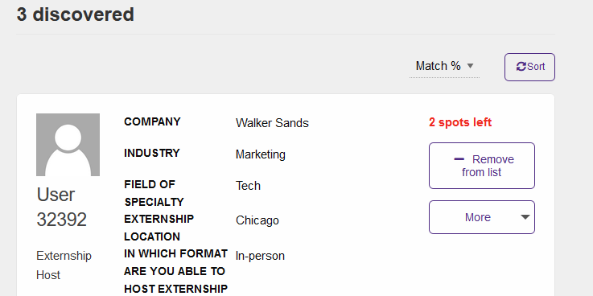
Note that alumni have a maximum number of applications they can receive. You will be alerted if a host is no longer available or if there are limited spots.
This is why you can now submit your apps one at a time to ensure you can apply to any that may have limited applications left. Be sure to refresh often to ensure the most accurate “spots left” numbers.
Notes:
NAA

Slide 12
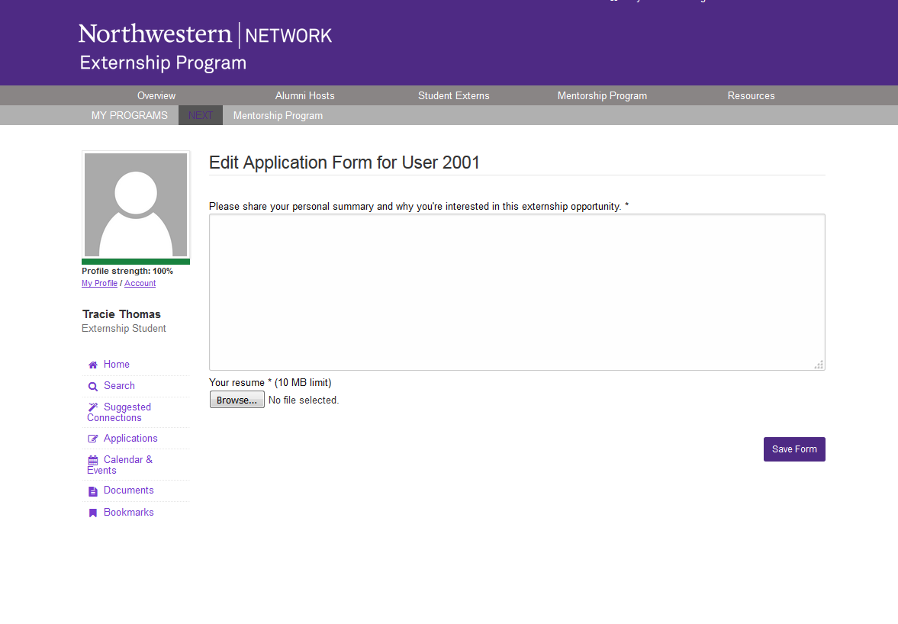
For each externship, submit an anonymous resume (no name or contact information) and a short essay on why you are interested in that externship.
MUST COMPLETE AND RANK BY November 12.
Notes:
NAA

Slide 13
Maximize Your Chances of Getting Matched
Getting matched is not guaranteed; the more externships to which you apply, the better your chance of being matched.
Consider ALL details about the externship to make sure it’s right for you (industry or type of work and the format [in-person or virtual])
You can apply to and rank up to 8 externships but will only be able to participate in 1 (if matched).
Apply to a variety of companies you are interested in.
Do your homework on the company and industry.
Customize your short essay: what attracts you to the company, what do you hope to gain from NEXT?
By applying to NEXT you are agreeing to participate
if matched with an alumni host
Notes:
NAA

Slide 14
What Your Day Might Look Like
Sample Agenda:
Time: Name/Location:
9:00 AM – 9:30 AM Welcome and walking tour of organization
9:30 AM – 10:00 AM Get to know each other and chat about career goals and NU
10:00 AM – 10:30 AM BREAK (restroom, coffee, step outside, etc.)
10:30 AM – 11:30 AM Join host’s team meeting to learn about current projects
11:30 AM – 12:00 PM Debrief team meeting and client expectation and goals
12:00 PM – 1:00 PM LUNCH
1:00 PM – 2:00 PM Resume review, industry trends, and hiring practices
2:00 PM – 3:00 PM Meeting with host’s colleague in another department
3:00 PM – 3:30 PM Meeting with HR to learn about roles and company specifics
3:30 PM – 4:30 PM Additional questions, how to stay in touch, and wrap up
Notes:
NCA

Slide 15
NEXT Training Session
**Training will be made available as soon as students are matched. It is mandatory.
Learn how to make your externship successful! You will learn to:
Effectively prepare for your externship
Use online resources to research career paths and/or organizations
Formulate good questions to ask your alumni host during your externship
Notes:
NCA

Slide 16

Questions?
Please contact us at:
next.student@northwestern.edu
Notes:
NCA

