Slide 1


NEXT Training Session
Northwestern Career Advancement
Northwestern Alumni Association

Slide 2

Definition and Expectations
What is an Externship?
  An opportunity to interact with and observe a professional in a career you might be interested in pursuing.
How long is an Externship?
  Typically, one day, though this can be negotiated between you and your alumni host.
What can I expect from an Externship?
  To gain experience and knowledge through observing and speaking with the host employer in their work environment (virtual or in-person).
Notes:
NCA
This opportunity will help you gain insight into the practical aspects of a potential future career.

Slide 3
Learning Outcomes
By participating in NEXT you will be able to:
List the typical duties associated with the job of the alumni host you shadow
Describe the skills/qualities needed to be successful in the job you observed
Articulate the advantages and disadvantages of pursuing a career in the industry you learned about through shadowing in the context of your personal skills, interests, and goals
Notes:
NCA

Slide 4

Logistics
By now you should:
Be matched with an alumni host
By Monday, December 22:
Connected with your alumni host
By the week of February 2:
Scheduled your externship date with your host
By early June:
Completed your externship
Notes:
When do students need to have scheduled their externship date with their hosts by this year? Last year it was roughly 2 weeks, but we need to make sure that the holiday season doesn’t interfere with their ability to plan

Slide 5

Milestones
Throughout the NEXT experience students will need to check off milestones to show their progress toward completing the experience
  Contacted Externship Host
  Scheduled Externship Day
  Completed Externship Day
Survey to follow
Notes:
NAA

Slide 6
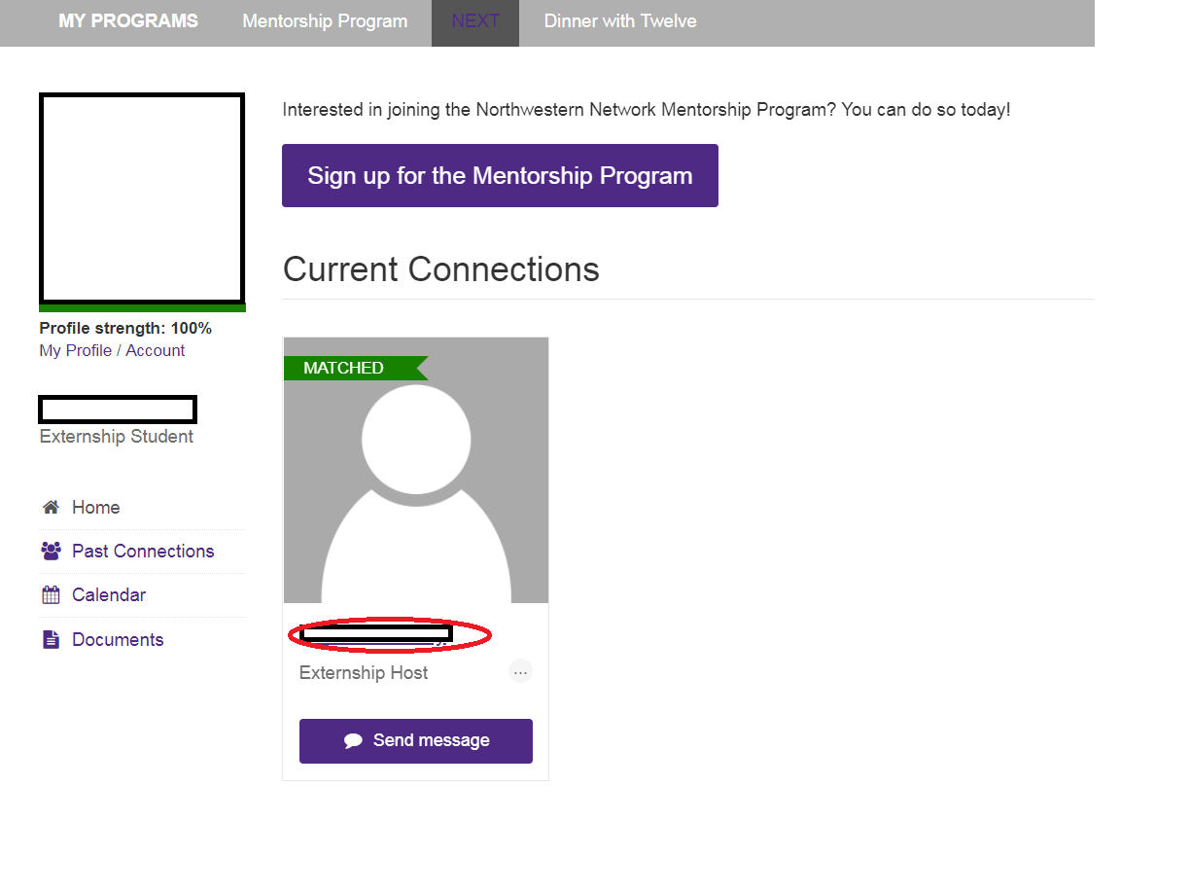
Accessing Milestones
Click on alumni host name
Notes:
NAA

Slide 7
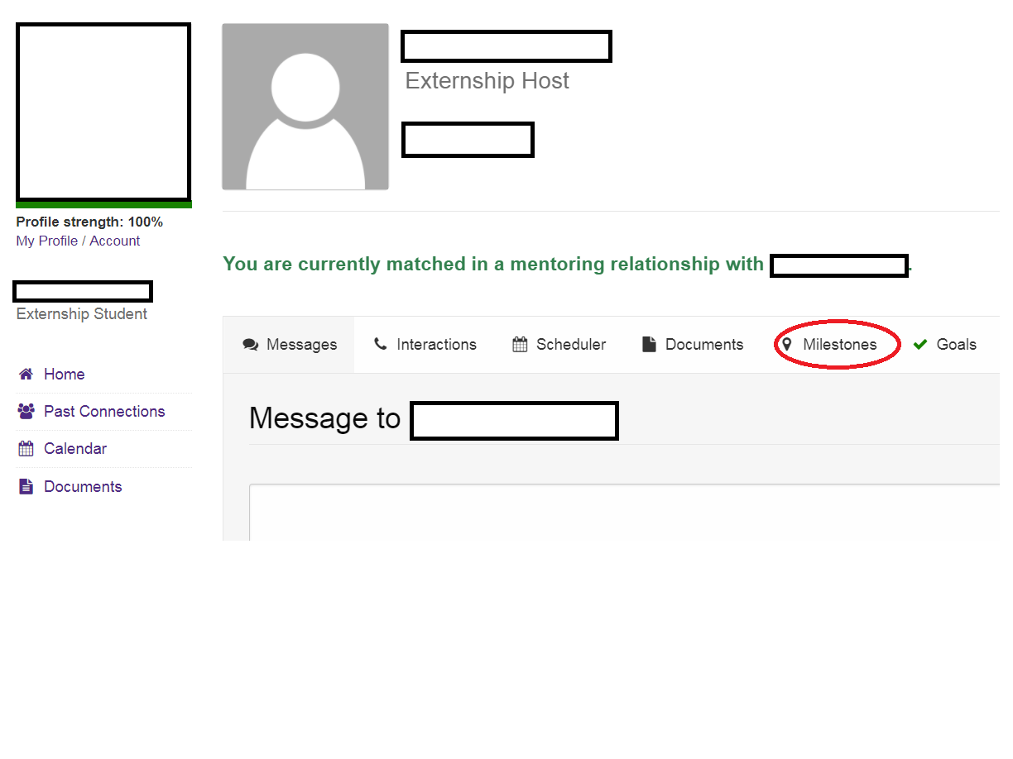
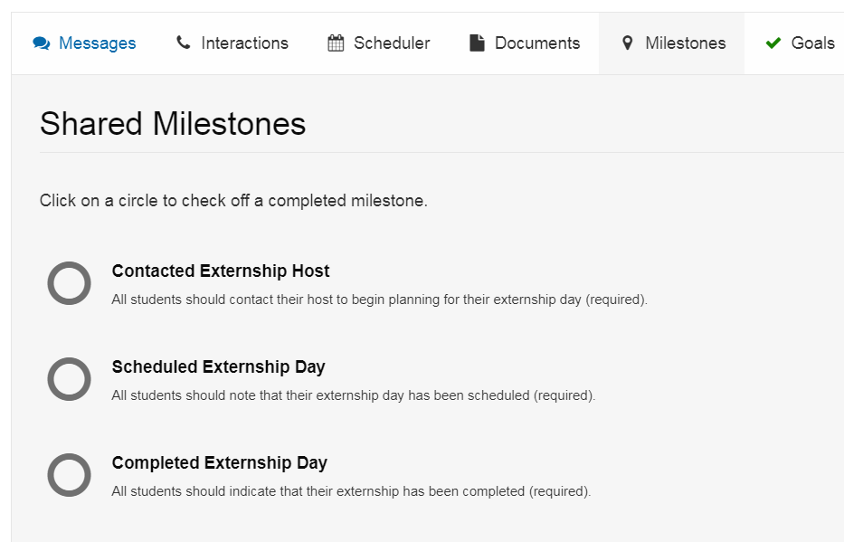
Click on Milestones
Check off milestones as you complete them
Notes:
NAA

Slide 8
Introductory Email
Reach out to the alumni host’s email (if available). If not, message in the platform.
  Follow up after a few days if you haven’t heard back
What to include:
  A thank you to the host for choosing you
  Details about your class year, major, school/college
  1-3 sentences about why you are interested in their company/career
  Next steps & logistics
    Ask what dates the alumni would like to host you (remember it’s according to their schedule)
Notes:
NAA
Will share this slide through email with students prior to the training as well since many may have already contacted their alumni hoost upon learning their match.

Slide 9

Before Externship
Questions to ask alumni host:
  What is the appropriate attire?
  What is the agenda or schedule for the day?
  Confirm additional logistics and details (address, virtual platform, parking, etc.)
Things to look up on your own:
  Host’s profile and company on LinkedIn
  Company mission and goals
Notes:
NAA
-Costs are students responsibility
-Be on Time:
Helps to maintain close partnerships between alumni and Northwestern
Demonstrates professionalism and respect for your volunteer
-Dress code – talk to your host
Lunch:
(Remember you are responsible for paying for your own lunch- Do not expect them to cover you, although if they offer you may certainly accept).”

Slide 10

Additional Things to Consider
Having a notepad and pen
nearby to take notes
Resume for review (optional)
Make sure your phone and other devices are on silent so that notifications are not disrupting the session
Plans for your break time to decompress from the work environment
Notes:
NAA

Slide 11
Dress Code
An externship is still an opportunity to make an impression on your host and their organization, whether virtual or in-person
If the attire is business professional and you do not own a suit, ask about the possibility of wearing a variation or what is needed depending on the agenda of the externship day
Notes:
NCA

Slide 12
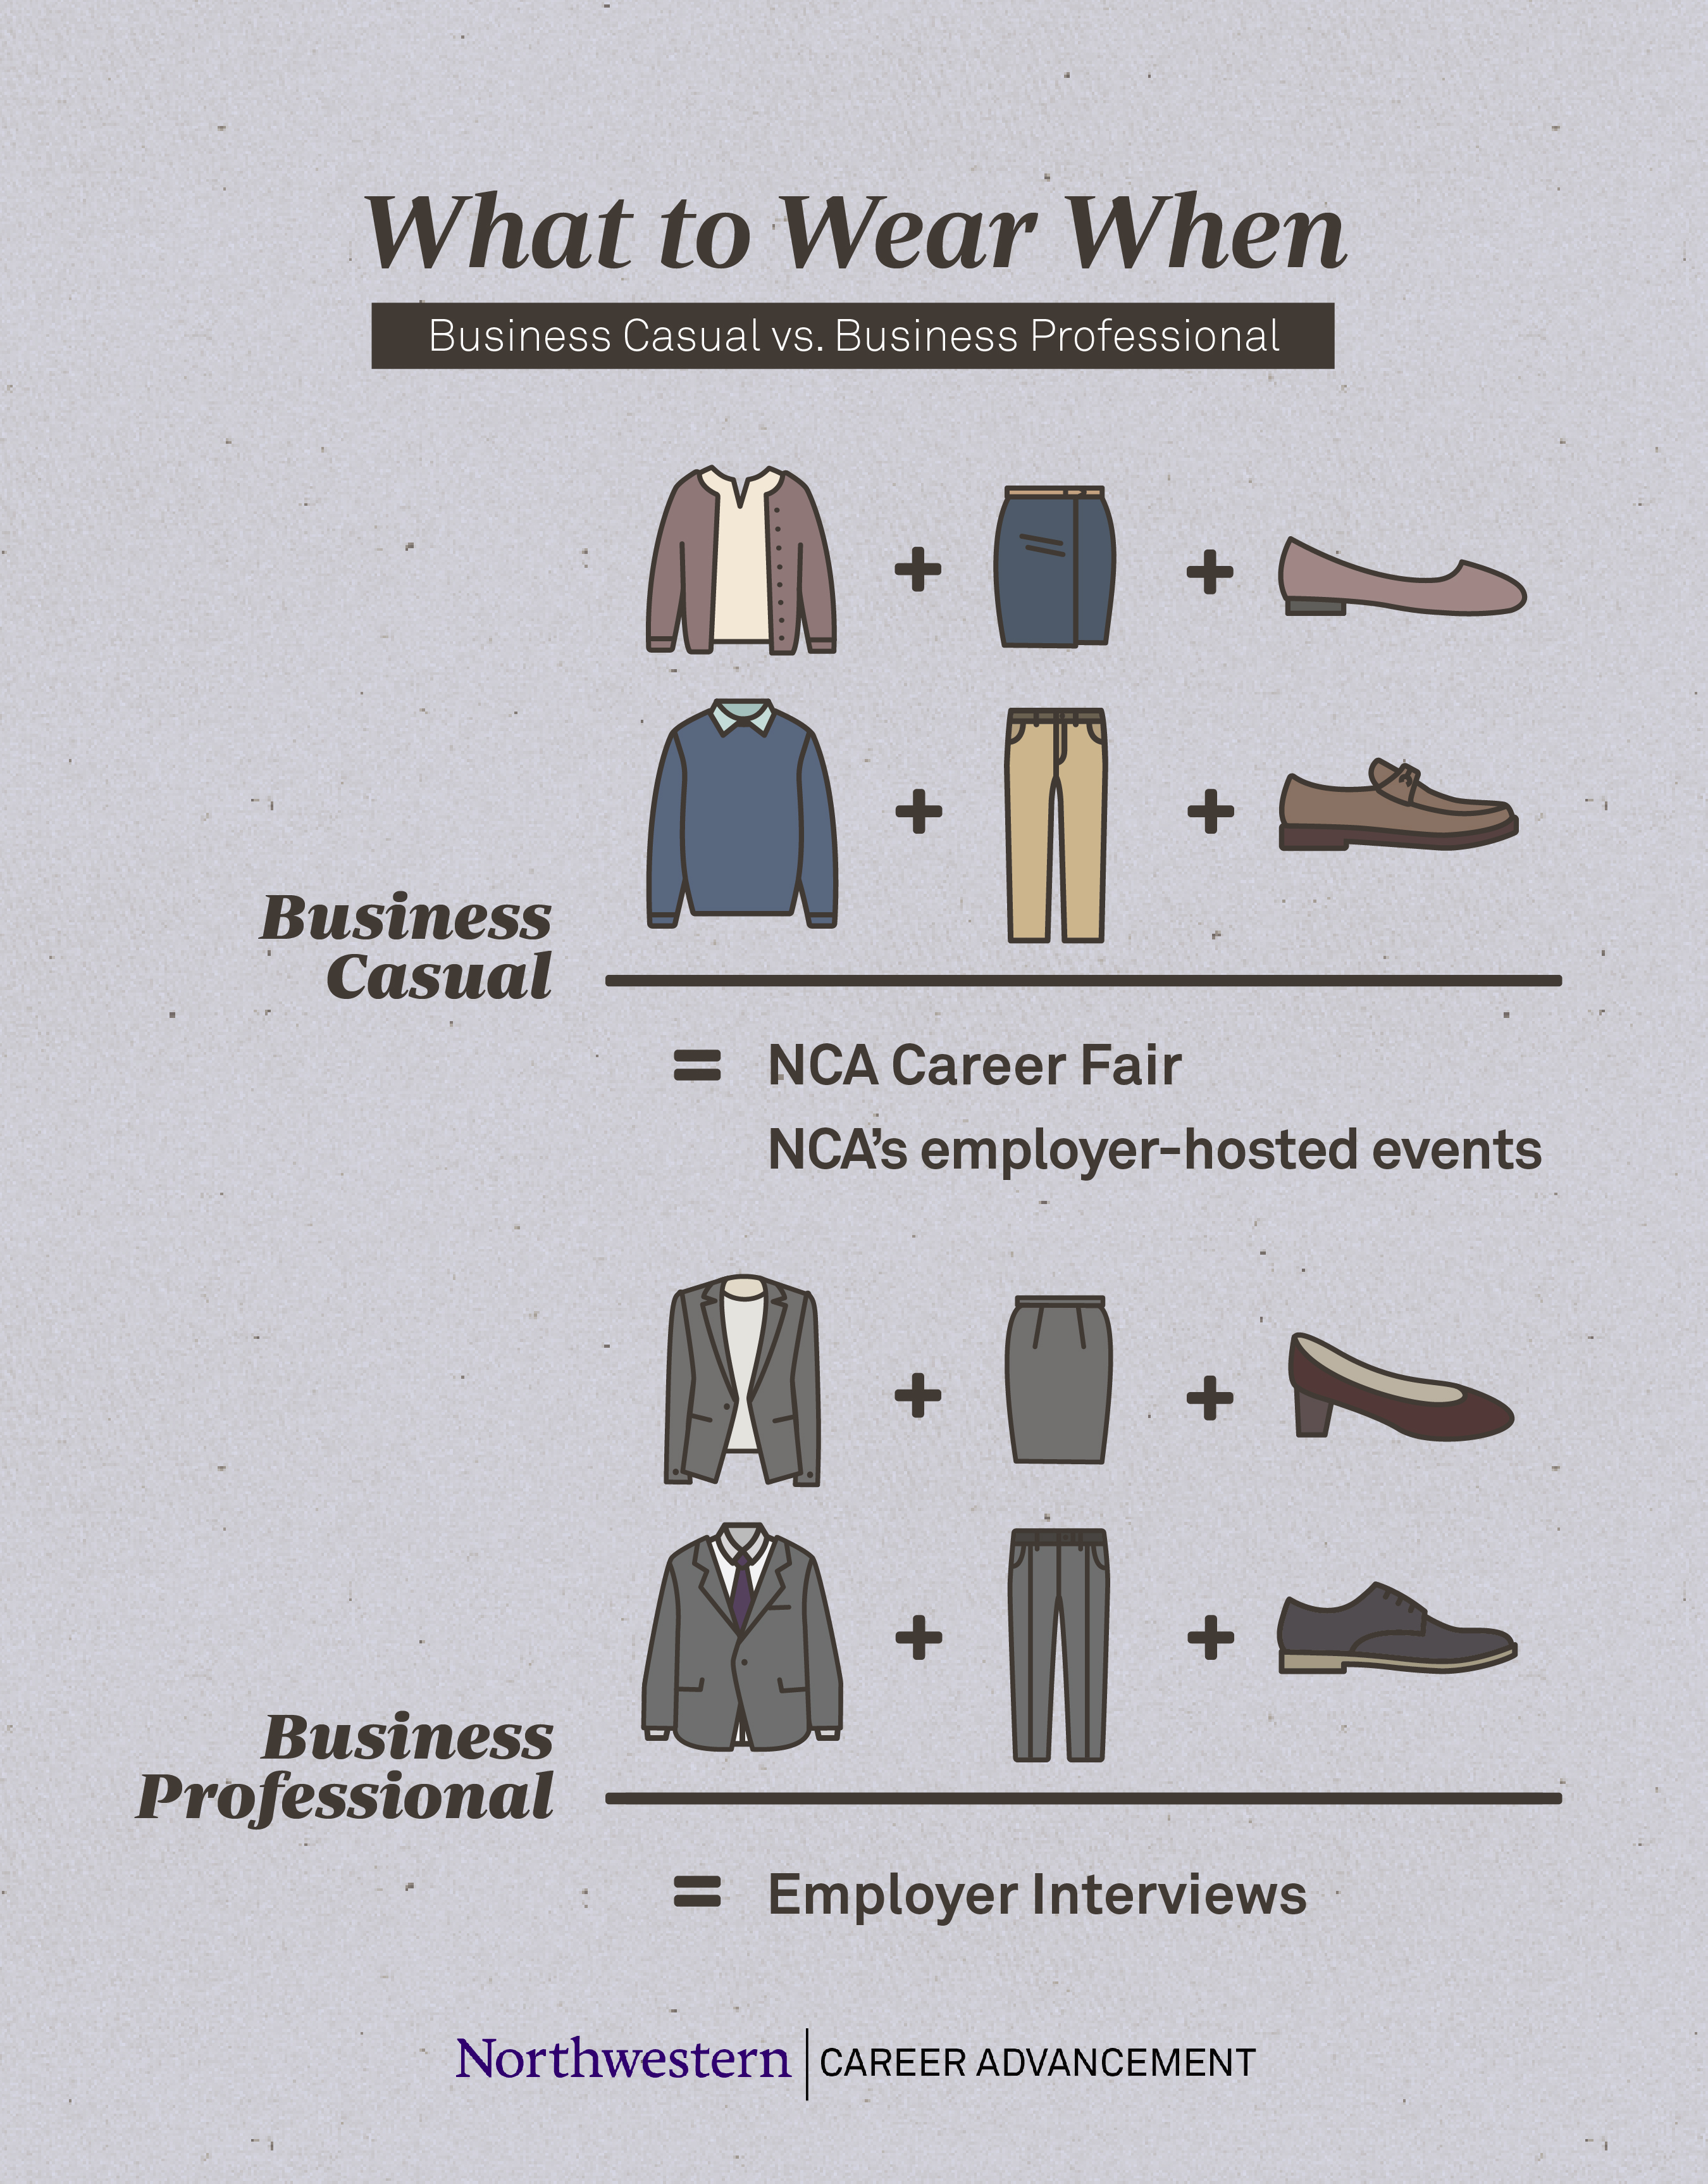
Business Casual vs. Business Professional
*More information on NCA’s website
Notes:
NCA

Slide 13
Preparing for Your Externship
Learn about the industry and the company prior to your scheduled day:
  Industry:
    What do people do in this industry?
    What are its functional areas?
    What kind of skill sets are expected?
    What are the current trends in this industry?
  Company:
    What is their mission/purpose?
    What are their philosophies and core values?
    What is their reputation with clients/customers?
    Has the company been in the news lately?
Notes:
NCA

Slide 14
Resources for Research
  Company Website
  About Us, PR Releases, Media, etc. for recent news about the organization
  LinkedIn
Glassdoor
Firsthand
Access through NCA
Website
Resources for career research and prep
Notes:
NCA
Give examples of professional organizations
Show Firsthand and click on “industries and professions” as well as company rankings
The Company website:
look under “PR Releases, about us, media, etc.

Slide 15
Create a Plan
Set goals and expectations with your alumni host
What questions do you want to have answered by the time you finish the day?
Ideas on how to use your time:
  Request a virtual or in-person tour if alum is on site
  Sit in on a meeting
  Watch your host “in action”
  Meet with other individuals
  Ask your host to review your resume
Notes:
NCA
SET GOALS AND EXPECTATIONS:
can help ensure the externship is a rewarding experience for all involved
Attempt to build in time 1:1 with your Sponsor and/or other associates to get answers to your questions
It may be a good idea to spend time with your Sponsor toward the end of your time, as your observations will elicit other questions

Slide 16
Sample Externship Day
Sample Agenda:
Time: Name/Location:
9:00 AM – 9:30 AM Welcome and walking tour of organization
9:30 AM – 10:00 AM Get to know each other and chat about career goals and NU
10:00 AM – 10:30 AM BREAK (restroom, coffee, step outside, etc.)
10:30 AM – 11:30 AM Join host’s team meeting to learn about current projects
11:30 AM – 12:00 PM Debrief team meeting and client expectation and goals
12:00 PM – 1:00 PM LUNCH
1:00 PM – 2:00 PM Resume review, industry trends, and hiring practices
2:00 PM – 3:00 PM Meeting with host’s colleague in another department
3:00 PM – 3:30 PM Meeting with HR to learn about roles and company specifics
3:30 PM – 4:30 PM Additional questions, how to stay in touch, and wrap up
Notes:
NCA

Slide 17
Potential Questions to Ask
Sample Goals | Sample Questions
To explore career fit | How did you decide on this career? How does this career fit your interests, values, and skills? What are your primary responsibilities? What skills are most important for success? What kind of person does well in this industry/company?
To prepare for a career in a specific industry | How did your time at NU (inside and outside the classroom) prepare you for this field? What are some challenges to working in this industry? What experiences should I engage in to be better prepared for this industry? How is this field/industry changing?
To learn about a specific company | It seems that every organization has its own personality. How would you characterize yours? What do you like most/least about working for this company?
To learn internship/job strategies | What are methods and resources for getting internships/jobs in this industry/company? What resources would you recommend I use to find an internship/job in this industry? Who else would you recommend I talk with about employment in this industry/company?
Notes:
NCA
One on one time is a great time to get to building a relationship with your host but also to find out if the company or industry is a good fit
Could ask audience “what other questions would be good to ask?”

Slide 18

Networking
What is it?
  Established professional or personal connections with others
Why do we do it?
  To develop a mutual support system
  To tap into a hidden employment market
  To interact with people who are members of your target field
  To explore career options
  To market yourself to potential employers
Notes:
NCA
You will be meeting your host as well as others. It’s a great opportunity to make sure that you develop a relationship with your host and others you may come into contact with during the day. This is called “networking”

Slide 19
Networking
Do:
  Listen and take notes (have something to take notes on; laptop, notebook, etc.)
  Guide the flow of conversation by using your goals and prepared questions
  Ask for referrals to other people in the field
Don’t:
  Ask for a job or internship
  Engage in negative conversations, gossip, or share unrelated information
  Act uninterested. Be aware of nonverbal behavior.
  Be afraid to ask questions
Notes:
NCA

Slide 20

Develop Your Story
Professional Story
  Offers information that allows someone to connect with you over a shared interest or experience. Be prepared to talk about yourself by developing a 30 second story
How to do it
  Create a brief introduction to who you are
    Offer a few key facts designed to generate a conversation allowing someone to get to know you.
  Highlight strengths
    Examples of what you enjoy or have become good at (from student activities, class, past or current internships)
  What have you learned from self-evaluation?
Notes:
NCA

Slide 21
During the Externship
Be enthusiastic, polite, inquisitive, and energetic
Take notes:
  Write down questions you have throughout the day
  Think of what you want to add to your resume about this experience
  Brainstorm ways to stay connected to your host based on the conversations you are having and things you can connect on after the externship
Avoid using your phone during the externship so you can stay engaged during the experience
Notes:
NCA

Slide 22
After Your Externship
Confirm that all milestones have been completed in the platform
Complete the required survey
Ask for contact information (“Do you mind if I have your email in case I think of any more questions?”)
Follow up with a thank you email within 48 hours
Write down what you learned about the industry, job and/or company and how it fits (or doesn’t) with your interests, values and skills
Add your experience to your resume:
EXPERIENCE
NBC News, New York, NY March, 2024
Extern
Shadowed Senior Producer to increase knowledge of national news show production
Learned job functions and responsibilities of staff integral to production
Notes:
NAA

Slide 23
After your Externship
Maintain your relationship with your new networking contact(s)
Set up new contact meetings for additional informational interviews (using LinkedIn & Our Northwestern)
Connect with NCA for help with:
  Further career exploration and self assessment
  Resume/cover letter reviews
  Internship and full-time job resources and search strategies
Connect with NAA:
  Join the Northwestern Network Mentorship Program
  Attend webinars and other events
Notes:
NAA

Slide 24
Alumni Quotes
  When asked What did you enjoy most about the externship program? alumni replied:
  “The chance to help out a fellow Wildcat. I also really appreciate that she spent a good deal of time researching so that she could ask great questions.”
  “It was fantastic to interact with a student interested in my field and provide her as many ‘legs up’ as I could.”
  “The opportunity to underscore the value of the NU alumni network to existing students.”
Notes:
NAA

Slide 25

Optional Social Media
Use our #WhatsNEXTNU26 when mentioning your externship on social media
  We would love to see the amazing connections that are being made between you and your alumni hosts
Find NCA at @NUCareerAdvance and NAA at @NorthwesternAlumni on Facebook, Instagram and Twitter. Tag us!
Notes:
Are we keeping this hashtag for this year? Ask Jess if we are creating a new one.

Slide 26
Other Important Information
It Can't Be Repeated Enough:
  You are representing Northwestern University during your externship
  Remember to be appreciative of your host
  If you have any questions, concerns, or issues that arise at any point, please contact us: next.student@northwestern.edu
  After the externship, there is no future obligation of any kind, by either the alumni host or the student.
  Have fun!
Notes:
NAA

